Slide 1
ATAI
Advanced Technique of Artificial Intelligence
ATAI
ChongqingUniversity _{AdvancedTechniqueof}
of Technology Artificial Intelligence
Chongqing University of
Technology
Chongqing University ^{ATAI}
_{of Technology} Advanced Techniqueof
Artificial Intelligence
Chongqing University of Technology
Chongqing University of Technology
HiPo: Detecting Fake News via Historical and Multi-Modal
Analyses of Social Media Posts
Code : None
—— CIKM’2023
Reported by Yang Jiang
1

Slide 2
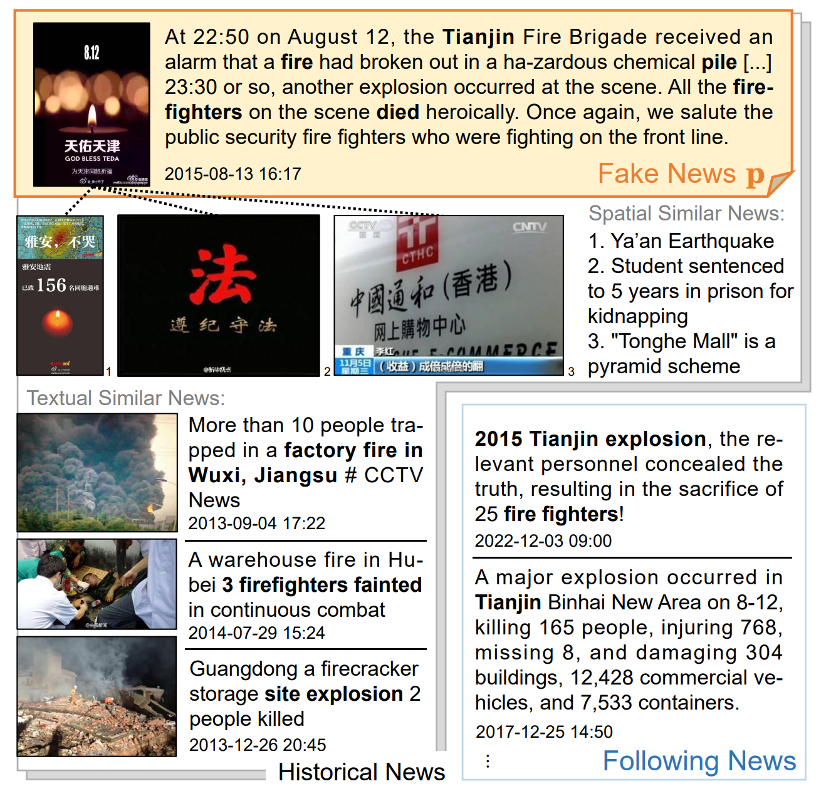
ATAI
Advanced Technique of Artificial Intelligence
ATAI
ChongqingUniversity _{AdvancedTechniqueof}
of Technology Artificial Intelligence
Chongqing University of
Technology
Chongqing University ^{ATAI}
_{of Technology} Advanced Techniqueof
Artificial Intelligence
Chongqing University of Technology
Chongqing University of Technology
INTRODUCTION
Label bias
due to the expensive labeling process and possible mislabeled news
Time bias
temporally inconsistent evaluations that integrate future knowledge about the testing objects into the training phase or create unrealistic settings

Slide 3
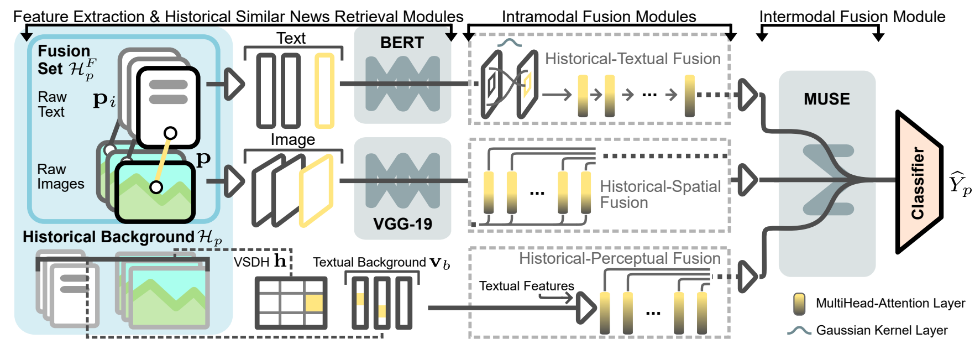
ATAI
Advanced Technique of Artificial Intelligence
ATAI
ChongqingUniversity _{AdvancedTechniqueof}
of Technology Artificial Intelligence
Chongqing University of
Technology
Chongqing University ^{ATAI}
_{of Technology} Advanced Techniqueof
Artificial Intelligence
Chongqing University of Technology
Chongqing University of Technology
Overview

Slide 4
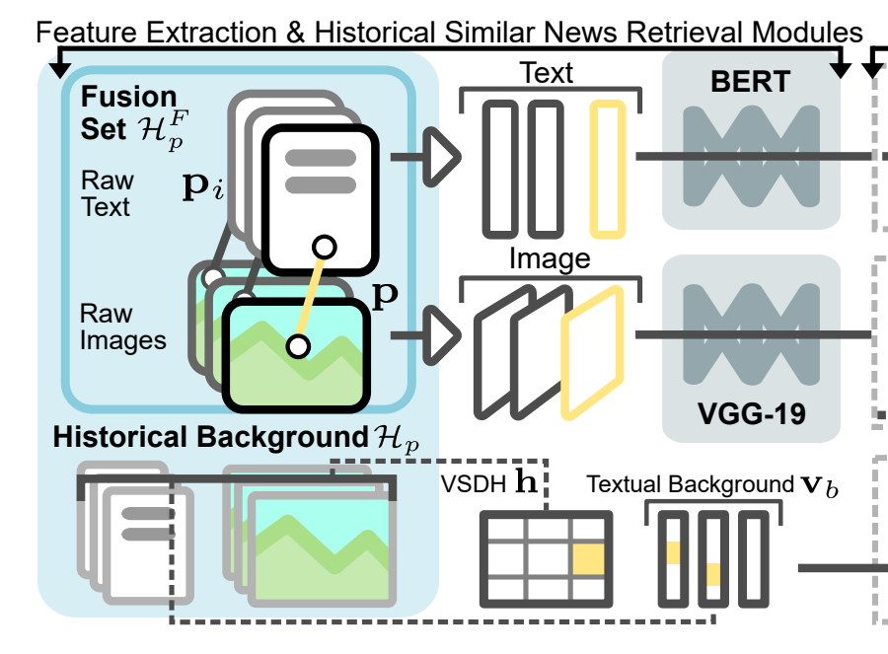
ATAI
Advanced Technique of Artificial Intelligence
ATAI
ChongqingUniversity _{AdvancedTechniqueof}
of Technology Artificial Intelligence
Chongqing University of
Technology
Chongqing University ^{ATAI}
_{of Technology} Advanced Techniqueof
Artificial Intelligence
Chongqing University of Technology
Chongqing University of Technology
Method
text
space

Slide 5
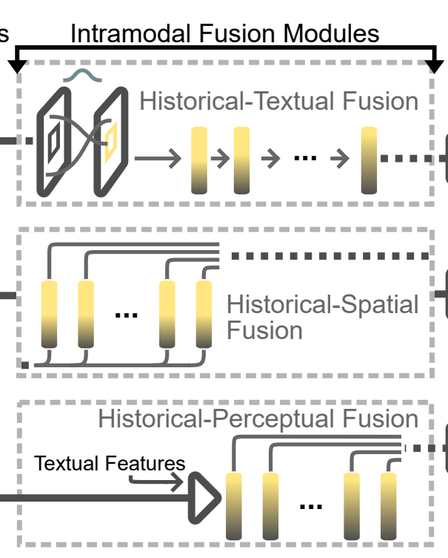
ATAI
Advanced Technique of Artificial Intelligence
ATAI
ChongqingUniversity _{AdvancedTechniqueof}
of Technology Artificial Intelligence
Chongqing University of
Technology
Chongqing University ^{ATAI}
_{of Technology} Advanced Techniqueof
Artificial Intelligence
Chongqing University of Technology
Chongqing University of Technology
Method

Slide 6
ATAI
Advanced Technique of Artificial Intelligence
ATAI
ChongqingUniversity _{AdvancedTechniqueof}
of Technology Artificial Intelligence
Chongqing University of
Technology
Chongqing University ^{ATAI}
_{of Technology} Advanced Techniqueof
Artificial Intelligence
Chongqing University of Technology
Chongqing University of Technology
Method

Slide 7
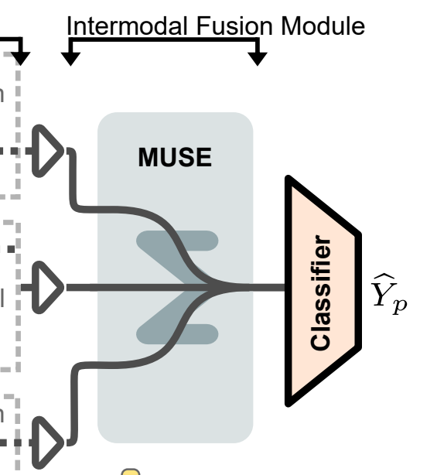
ATAI
Advanced Technique of Artificial Intelligence
ATAI
ChongqingUniversity _{AdvancedTechniqueof}
of Technology Artificial Intelligence
Chongqing University of
Technology
Chongqing University ^{ATAI}
_{of Technology} Advanced Techniqueof
Artificial Intelligence
Chongqing University of Technology
Chongqing University of Technology
Method

Slide 8
ATAI
Advanced Technique of Artificial Intelligence
ATAI
ChongqingUniversity _{AdvancedTechniqueof}
of Technology Artificial Intelligence
Chongqing University of
Technology
Chongqing University ^{ATAI}
_{of Technology} Advanced Techniqueof
Artificial Intelligence
Chongqing University of Technology
Chongqing University of Technology
Experiments

Slide 9
ATAI
Advanced Technique of Artificial Intelligence
ATAI
ChongqingUniversity _{AdvancedTechniqueof}
of Technology Artificial Intelligence
Chongqing University of
Technology
Chongqing University ^{ATAI}
_{of Technology} Advanced Techniqueof
Artificial Intelligence
Chongqing University of Technology
Chongqing University of Technology
Experiments

Slide 10
ATAI
Advanced Technique of Artificial Intelligence
ATAI
ChongqingUniversity _{AdvancedTechniqueof}
of Technology Artificial Intelligence
Chongqing University of
Technology
Chongqing University ^{ATAI}
_{of Technology} Advanced Techniqueof
Artificial Intelligence
Chongqing University of Technology
Chongqing University of Technology
Experiments

Slide 11
ATAI
Advanced Technique of Artificial Intelligence
ATAI
ChongqingUniversity _{AdvancedTechniqueof}
of Technology Artificial Intelligence
Chongqing University of
Technology
Chongqing University ^{ATAI}
_{of Technology} Advanced Techniqueof
Artificial Intelligence
Chongqing University of Technology
Chongqing University of Technology
Experiments

Slide 12
ATAI
Advanced Technique of Artificial Intelligence
ATAI
ChongqingUniversity _{AdvancedTechniqueof}
of Technology Artificial Intelligence
Chongqing University of
Technology
Chongqing University ^{ATAI}
_{of Technology} Advanced Techniqueof
Artificial Intelligence
Chongqing University of Technology
Chongqing University of Technology
Experiments

Slide 13
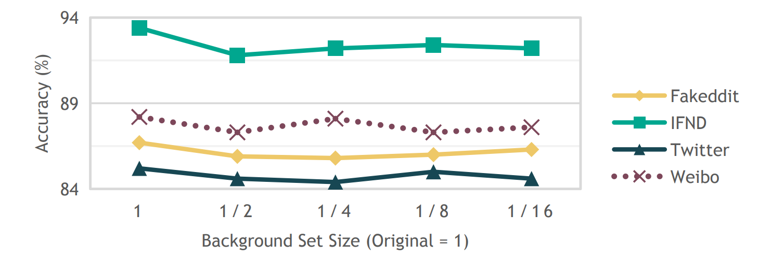
ATAI
Advanced Technique of Artificial Intelligence
ATAI
ChongqingUniversity _{AdvancedTechniqueof}
of Technology Artificial Intelligence
Chongqing University of
Technology
Chongqing University ^{ATAI}
_{of Technology} Advanced Techniqueof
Artificial Intelligence
Chongqing University of Technology
Chongqing University of Technology
Experiments

Slide 14
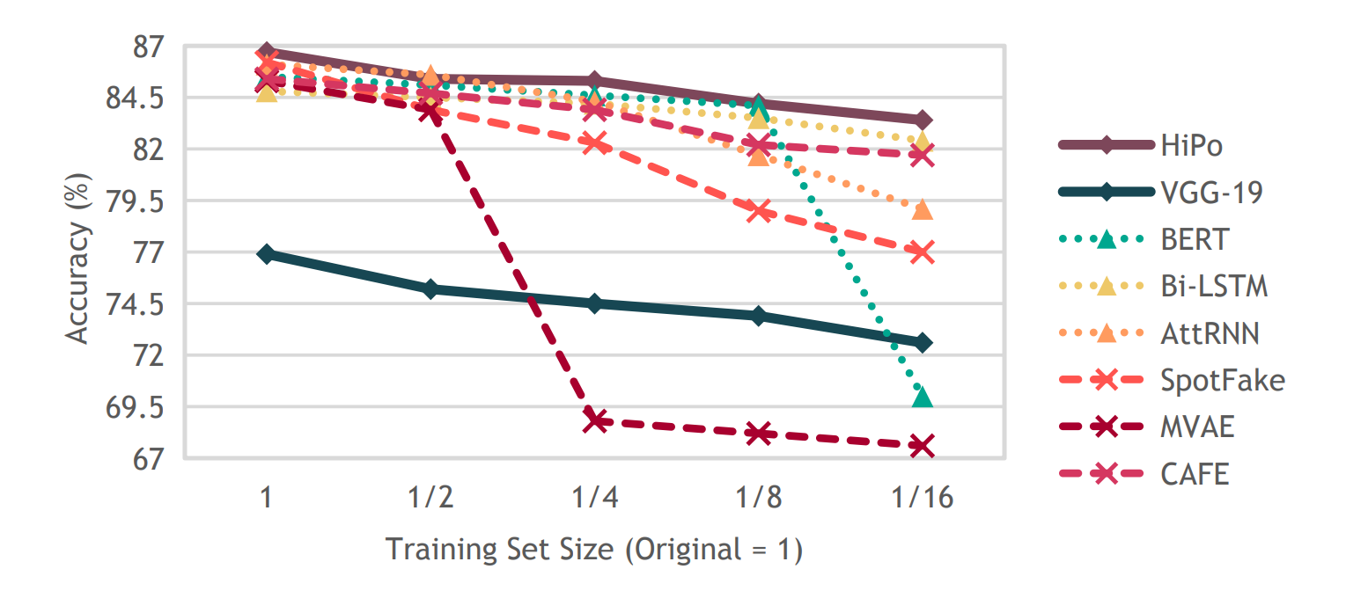
ATAI
Advanced Technique of Artificial Intelligence
ATAI
ChongqingUniversity _{AdvancedTechniqueof}
of Technology Artificial Intelligence
Chongqing University of
Technology
Chongqing University ^{ATAI}
_{of Technology} Advanced Techniqueof
Artificial Intelligence
Chongqing University of Technology
Chongqing University of Technology
Experiments

Slide 15
ATAI
Advanced Technique of Artificial Intelligence
ATAI
ChongqingUniversity _{AdvancedTechniqueof}
of Technology Artificial Intelligence
Chongqing University of
Technology
Chongqing University ^{ATAI}
_{of Technology} Advanced Techniqueof
Artificial Intelligence
Chongqing University of Technology
Chongqing University of Technology
Experiments

Slide 16
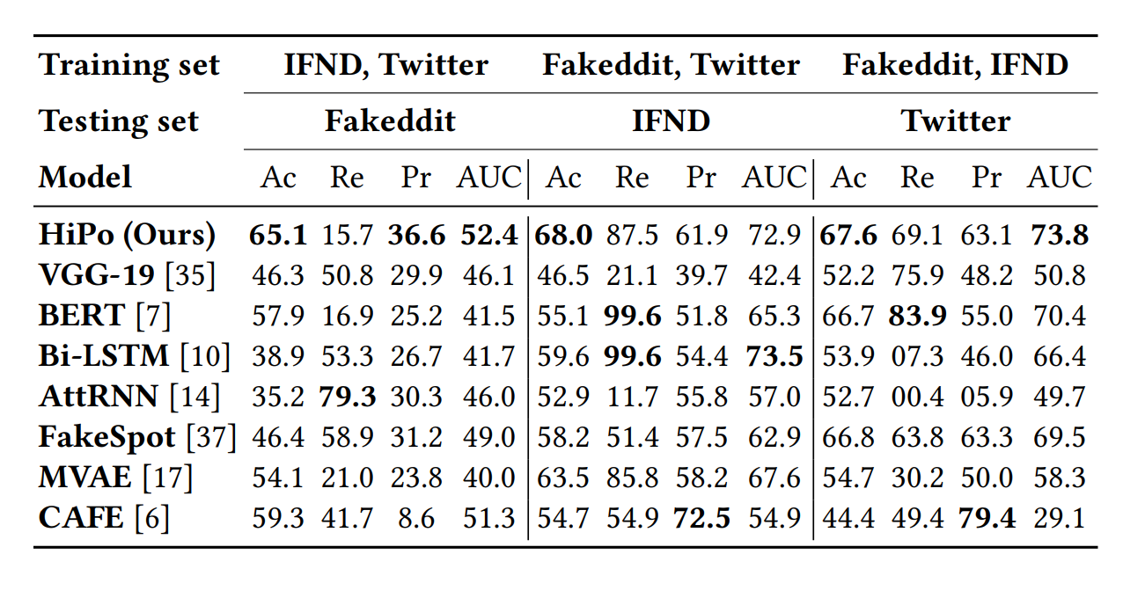
ATAI
Advanced Technique of Artificial Intelligence
ATAI
ChongqingUniversity _{AdvancedTechniqueof}
of Technology Artificial Intelligence
Chongqing University of
Technology
Chongqing University ^{ATAI}
_{of Technology} Advanced Techniqueof
Artificial Intelligence
Chongqing University of Technology
Chongqing University of Technology
Experiments

Slide 17
ATAI
Advanced Technique of Artificial Intelligence
ATAI
ChongqingUniversity _{AdvancedTechniqueof}
of Technology Artificial Intelligence
Chongqing University of
Technology
Chongqing University ^{ATAI}
_{of Technology} Advanced Techniqueof
Artificial Intelligence
Chongqing University of Technology
Chongqing University of Technology
Thanks!

